Slide 1
Golang vs Python
Hung Pham, Software Engineer

Slide 2
Agenda
What is Golang?
Golang advantages and disadvantages
What is Python?
Python advantages and disadvantages
When to use Golang vs Python
How can we benefit from Golang?
Discussion

Slide 3
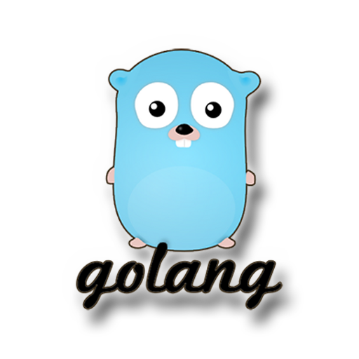
What is Golang?
Often referred to simply asGo, is an open-source programming language developed by Google. Go is a great choice when building scalable, high-performance, cloud-based applications, microservices, or system-level software. Its concurrency model, simplicity, and strong standard library make it particularly well-suited for server-side programming and large-scale, distributed systems.

Slide 4
Advantages and disadvantages of Go
Advantages | Disadvantages
Efficient Concurrency: Go’s goroutines allow for scalable, highly concurrent applications. | Verbose Error Handling: Go’s lack of exceptions means error handling can be verbose and repetitive.
Simplicity: Go’s minimalist design and clear syntax help developers write clean, maintainable code. | No Native GUI Support: Go isn’t designed for desktop applications with graphical interfaces.
Fast Performance: Go compiles to machine code, offering high performance and low memory consumption. | Limited Ecosystem in Certain Areas: While Go excels in backend and infrastructure development, its ecosystem in fields like data science or web development is still growing.
Easy Deployment: Compiling to a single binary makes deploying Go applications straightforward, especially in containerized environments. | Manual Memory Management (To Some Extent): While Go has garbage collection, memory management is not fully automated in the way it is in languages like Python or Java. Developers still need to be mindful of how memory is used, and excessive allocation or deallocation can affect performance.
Open-source: Licensed under the Apache 2.0, making it free for commercial use with active | Opinionated Language Design: Go’s designers made several opinionated decisions that some developers may find restrictive. For example, the language insists on strict formatting rules (enforced by tools like gofmt) and has limited syntactic sugar. This can be frustrating for developers who are used to more flexible languages.
Mesa Confidential

Slide 5

What is Python?
Python is a high-level, interpreted programming language. It is designed with an emphasis on code readability and simplicity, which makes it one of the most popular and widely used programming languages today. It is suitable for a wide variety of applications, from web development and automation to data science and artificial intelligence.
Mesa Confidential

Slide 6
Advantages and disadvantages of Python
Advantages | Disadvantages
Ease of Learning: Python’s simple syntax, lack of verbosity, and clean design make it one of the easiest languages to learn for beginners. | Performance: Python is slower than compiled languages like C, C++, or Go because it is interpreted. For CPU-intensive tasks, Python’s performance may not be suitable without using external libraries or rewriting critical parts in a faster language.
Versatility: Python is a general-purpose language and can be used across a wide range of domains, from web development and data science to machine learning and scripting. | Global Interpreter Lock (GIL): Python’s GIL prevents multiple native threads from executing simultaneously in multi-core systems. This can be a limitation for CPU-bound programs that require multi-threading, though it’s less of a problem for I/O-bound or concurrent applications.
Large Ecosystem and Libraries: Python’s vast ecosystem includes libraries and frameworks for almost every conceivable task. This reduces the need to build everything from scratch and allows developers to focus on the unique parts of their application. | Mobile Development: Python is not commonly used for mobile application development. While tools like Kivy allow for cross-platform development, Python is generally not the first choice for mobile apps due to performance limitations and the lack of robust frameworks.
Strong Community: Python’s popularity ensures that there is a large community providing support, maintaining libraries, and creating tools, which accelerates development. | Weak in Memory-Intensive Tasks: Python’s automatic memory management (via garbage collection) can lead to higher memory usage, making it less efficient for applications that require tight memory management or low-latency operations.
Cross-Platform Compatibility: Python runs on all major platforms and can be deployed in many environments with minimal modification.
Mesa Confidential

Slide 7
When to use Go vs Python
Go | Python
Web Servers and APIs: Build efficient, high-performance web servers and RESTful APIs. Frameworks like Gin and Echo simplify this process. | Web Development: Python is widely used for building websites and web applications, thanks to frameworks like Django and Flask, which allow for rapid development and deployment.
Cloud and Distributed Systems: Go is popular in the cloud-native and DevOps ecosystem, powering tools like Docker, Kubernetes, Terraform, and Prometheus. Its concurrency model and performance make it ideal for building scalable cloud services. | Data Science and Machine Learning: Python is the dominant language in data science, artificial intelligence (AI), and machine learning (ML) due to libraries like NumPy, Pandas, Scikit-learn, TensorFlow, and PyTorch. Its ability to handle data processing and visualization makes it a go-to for researchers and data analysts.
Microservices: Developing microservices due to its speed, simplicity, and ability to handle high concurrency. | Automation and Scripting: Python excels in scripting and automating repetitive tasks, from system administration and file manipulation to web scraping and data collection.
Networking Tools: Go’s standard library includes extensive support for building networking tools, including HTTP, TCP, and UDP protocols. | Scientific Computing: Python is popular in the scientific community for tasks like statistical analysis, simulation, and numerical computation. Libraries like SciPy and Matplotlib facilitate this kind of work.
 | Artificial Intelligence and Deep Learning: Python’s rich ecosystem of AI and deep learning libraries (e.g., Keras, TensorFlow, PyTorch) makes it a leading choice for developing neural networks and AI applications.
Mesa Confidential

Slide 8
How can we benefit from Golang?
Golang benefits
Golang is a perfect fit for cloud services. As our CM system moves to the cloud, building it as modular microservices allows us to leverage Golang's high performance, scalability, and cross-platform capabilities, making it the ideal choice
Golang enables us to redesign our CM cloud system with a modular, microservices architecture, decoupling it from the monolithic application. We can build smaller, focused microservices for specific tasks like reporting, emailing, alerting, user registration, real-time dashboard updates via websocket technology, processing sensor data, database operations, and more. By connecting these individual microservices, we create a cohesive CM cloud system that is easier to maintain, troubleshoot, and update. Each microservice can be updated or fixed independently without impacting the others.
Our CM cloud-based system needs to support local (on-prem) deployment. Golang's cross-platform compatibility makes it easier to deploy across different operating systems as needed.
Our CM system processes large volumes of sensor data from multiple sources while performing various tasks concurrently. Golang's strong concurrency support makes it ideal for handling these simultaneous operations efficiently.
Our software team will benefit greatly if using Golang due its strong standard library and a growing community and ecosystem.
Mesa Confidential

Slide 9

Mesa Confidential

